Slide 1

PHISHING DETECTION
CMR COLLEGE OF ENGINEERING & TECHNOLOGY
Kandlakoya, Medchal, Hyderabad – 501401
Department of CSE - Cyber Security
(BATCH – 18)
Under esteemed guidance of
Dr.Punyaban Patel
(Professor, CSC)
Name of the student Roll No.
1. G.Charan Sai 20H51A6279
2. A.Rishika 20H51A6297
3. G.Dheeraj Reddy 20H51A62A0

Slide 2

Outline
1.Abstract
2.Introduction
3.Literature Survey
4.Existing Systems
a. Problems in Existing System
5.Problem Definition
6.Proposed System
a. Architecture
b. Methodology
c. System Requirements
d. Proposed system vs Existing System.
7.Conclusion
8.References

Slide 3
ABSTRACT

Slide 4

Abstract
Phishing is a form of Social Engineering and Scam.
Purpose : Login credentials , Financial details
Phishing detection is the process of identifying ,alerting and mitigating the phishing attacks.
Phishing is a semantics-based attack, that mainly focuses on human vulnerabilities.
Our project is designed to enhance online security .
This comprehensive approach involves :
URL analysis
Database comparison
Greek Alphabet Analysis ,Homographic Attack URLs
Port forwarding detection

Slide 5
INTRODUCTION

Slide 6
Introduction
Phishing is an attack in which the threat actor poses as a trusted person or organization .
These attacks consists of three main entities.They are:
THE SENDER: The sender imitates someone trustworthy and the phishing messages mimic emails from large companies like PayPal, Amazon, or Microsoft, and also banks or government offices.
THE MESSAGE: The attacker will ask the recipient to click a link, download an attachment, or to send money or they create an emergency situation.
THE DESTINATION: If users click the link, they're sent to an imitation of a legitimate website. From here, they're asked to log in with their username and password credentials.

Slide 7
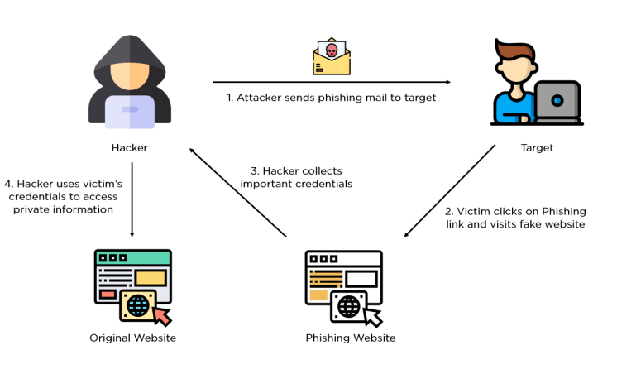
OVERVIEW OF A PHISHING ATTACK

Slide 8
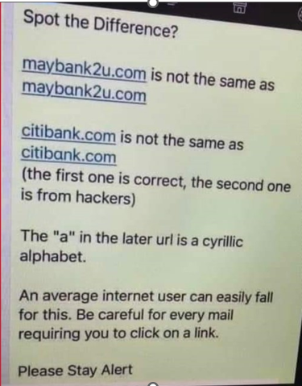


How does a Phishing Attack look like?

Slide 9
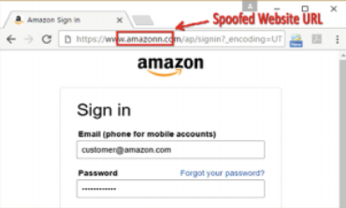
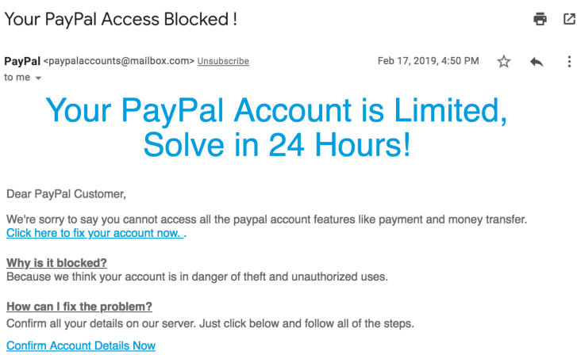
www.amazonn.com

Slide 10
LITERATURE SURVEY

Slide 11

Literature Survey
1) Email based Spam Detection: June-2020
AUTHOR :Thashina Sultana, K A Sapnaz, Fathima Sana, Mrs. Jamedar Najath
Published by International Journal of Engineering Research & Technology (IJERT)
https://www.researchgate.net/publication/342113653_Email_based_Spam_Detection
2) SemanticPhish : Nov- 2020
AUTHOR :Guy-Vincent Jourdan, Gregor v. Bochmann
Published by Institute of Electrical and Electronics Engineers (IEEE)
https://ieeexplore.ieee.org/document/9493252/authors#authors

Slide 12
EXISTING SYSTEMS

Slide 13
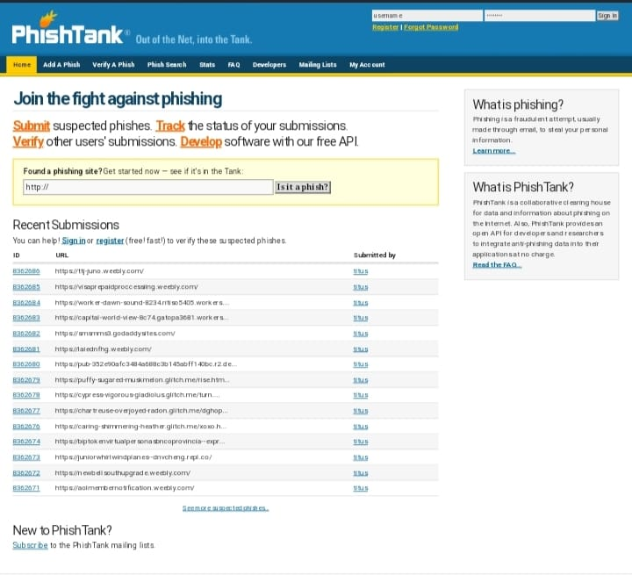
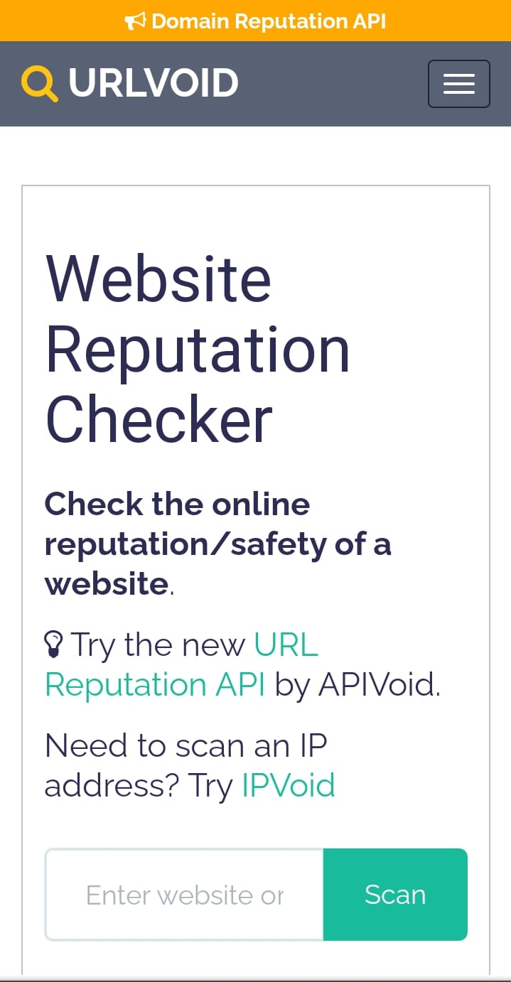
Existing Systems
1.PhishTank: PhishTank is a community-driven website that tracks known phishing websites. You can search their database or report suspicious URLs.
2.URLVoid: URLVoid provides a website reputation checker that scans websites against multiple blacklists and security services. It can help you determine the trustworthiness of a website.

Slide 14

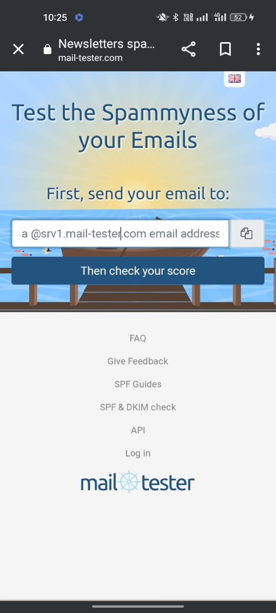
3.CheckPhish: CheckPhish is an online tool that allows you to analyze and check the legitimacy of a website.
4.Mail Tester: Mail Tester is an email validation service that can help you verify if an email address is legitimate. While it doesn't specifically detect phishing, it can be useful in verifying the authenticity of email senders.

Slide 15

Problems in Existing Solutions:
Less Accuracy
Inability to Detect unknown attacks
High False Acceptance Rate
Not using multi layered approach

Slide 16
PROBLEM DEFINITION

Slide 17

Problem Definition
Phishing websites are duplicate web pages created to mimic real websites in-order to deceive people to get their personal information. Identifying these phishing websites is typically a challenging task because phishing is mainly a semantics-based attack, that mainly focuses on human vulnerabilities, not the network or software vulnerabilities. Most of the phishing attacks are sent via email.

Slide 18
PROPOSED SYSTEM

Slide 19
Proposed Solution
Our proposed system is a website with comprehensive and multi-layered solution .
The system begins by
Meticulously scrutinizing the structure of the URL , alerting users to potential threats based on linguistic anomalies.
It then compares provided URLs to an extensive database of known phishing and malware-infested websites, offering instant alerts in case of a match.
To further fortify security, we investigate the URLs for any port forwarding techniques, a common method used by cybercriminals.
Finally, our system conducts Greek alphabet analysis, Homographic attack URLs specifically targeting the presence of Greek characters within URLs and alerting the users or administrators.

Slide 20
ARCHITECTURE / BLOCK DIAGRAM

Slide 21
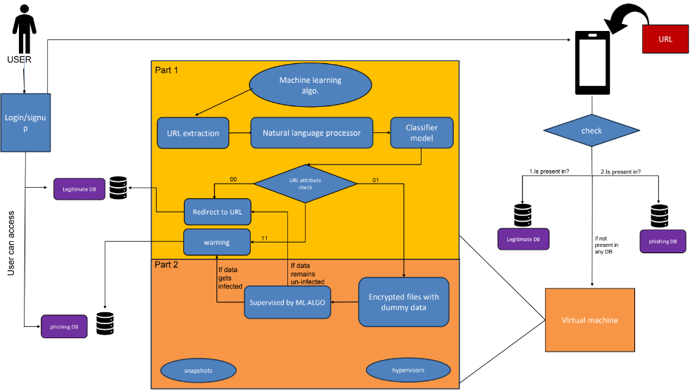

Slide 22
METHODOLOGY

Slide 23

Methodology
This comprehensive approach involves several layers of analysis to assess the legitimacy of URLs. The URL which we want to check has to be entered in the text box and click on the submit button for the result.
URL Analysis
Database Comparison
Port Forwarding Detection
Greek Alphabet Analysis and Homographs

Slide 24
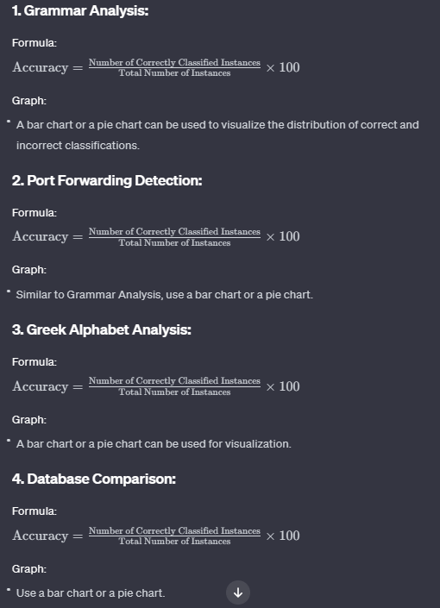
Accuracy of each approach

Slide 25
System Requirements
Hardware Requirements:
RAM : 16 GB or above
Processor : intel i5 or above
Software Requirements:
Operating System (used) : Windows
Programming Language : Python
Technologies used : Python Libraries , Flask framework
Editor : Visual Studio code

Slide 26
PROPOSED vs EXISTING SYSTEM
More Accurate | Less Accurate
Can detect unknown attacks and alert the users | Inability to Detect unknown attacks
Multi- Layered Approach | Single – Layered Approach
PROPOSED SYSTEM
EXISTING SYSTEM

Slide 27

Conclusion
Our project is a major advancement in online security, countering phishing and malware threats with a multi-layered approach.
Our system detects semantic anomalies and evolving cybercriminal techniques, promptly alerting users.
We aim to significantly reduce phishing and malware success rates, creating a safer digital environment.

Slide 28

Future Scope :
Extension for e-mail and message application:
Sending the phishing mails and messages directly to the spam folder of email and messaging application respectively.
User Education:
Develop features or modules that provide educational content to users, helping them recognize and avoid phishing attempts. This could include interactive tutorials, quizzes or simulated phishing exercises.

Slide 29
REFERENCES
1)Author: Emalderson ,Published in the year 2022
https://github.com/emalderson/ThePhish 2) Author : Ashit kumar Datta, Published on 2021 Oct https://www.ncbi.nlm.nih.gov/pmc/articles/PMC8504731/
3) Author : Fatima Salahdine, Zakaria El Mrabet, Naima Kaabouch, Published on 2022 January. https://www.researchgate.net/publication/358142755_Phishing_Attacks_Detection_--
4) https://www.sciencedirect.com/science/article/pii/S1319157823000034

Slide 30
THANKYOU

